Slide 1






A BTMA 431 Project
Lan
Levi
Chris
Lauren
Notes:
Photo sources:
- background https://www.wallpaperflare.com/green-grass-field-under-blue-skies-digital-wallpaper-pixel-art-wallpaper-hmews
- pokemon logo https://www.freepnglogos.com/pics/pokemon-logo-png

Slide 2

Welcome, BTMA 431!
Today we are performing a data analysis in the world of Pokémon...

Slide 3

OVERVIEW OF THE GAME
METHODOLOGY
RESULTS
QUESTION 1
QUESTION 2
QUESTION 3
QUESTION 4
Today we will discuss…

Slide 4
OVERVIEW OF THE GAME
METHODOLOGY
RESULTS
QUESTION 1
QUESTION 2
QUESTION 3
QUESTION 4
Today we will discuss…

Slide 5
OVERVIEW OF THE GAME
METHODOLOGY
RESULTS
QUESTION 1
QUESTION 2
QUESTION 3
QUESTION 4
Today we will discuss…

Slide 6

!
!
PLAYER: "How do I play?
Which Pokémon should I bring???"
Notes:
INTRODUCING THE GAME – Pokemon is a video game series where players, called trainers, roam the in game world searching for Pokemon to catch and battle. The slogan "gotta catch 'em all" has been the motto of the game since its first North American release in 1998. While you don't have to catch all the pokemon in the game, it is one major aspect of the game as you challenge other trainers and progress to become the Pokemon Region Champion. This brings us to our main question, which Pokemon should I bring to battle?

Slide 7


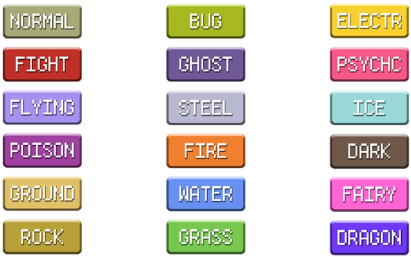
Pokémon
Pokédex
Pokémon Types
Notes:
OVERVIEW OF GAME
What you see on your left is Pikachu. It is an electric type Pokemon, and has Pokedex number 25. A Pokemon's type determines what Pokemon it is super effective against in battle, and what Pokemon types it resists against. When a Pokemon is weak to another Pokemon, it takes double the damage. When a Pokemon resists another Pokemon, it takes half the damage. There are 18 different types in the game, as shown on the slide. Additionally, each Pokemon has a set of base stats that determine if it is good for battle. These stats are broken down into six categories—attack, defense, special attack, special defense, speed, and HP. We will go more in depth about the first 4 stats later in this presentation.
Finally, in the middle of your screen you see a Pokedex. In the game, the Pokedex is used to register information about Pokemon when you catch one. One of the main points of the game is that you are "researching" Pokemon for the professor, and you register your findings in the Pokedex. A Pokedex number is how Pokemon are indexed within the Pokedex. Each mainseries Pokemon game brings new Pokemon, and what is called a generation.
Explain pokemon generations
Explain how pokemon types work
Picture sources (left to right)
https://www.pngitem.com/middle/hwmRxwh_pokemon-transparent-pixel-art-pokemon-pikachu-sprite-gif/
https://pokemonreturnofthechampion.fandom.com/wiki/Pok%C3%A9dex_Holders
https://www.deviantart.com/pokemoncardresources/gallery/29632989/custom-icons-and-symbols

Slide 8
Pokémon Generation | Original Game | Location | Number of New Pokémon
Generation One (I) | Red & Yellow | Kanto | 151
Generation Two (II) | Gold & Silver | Johto | 100
Generation Three (III) | Ruby & Sapphire | Hoenn | 135
Generation Four (IV) | Diamond & Pearl | Sinnoh | 107
Generation Five (V) | Black & White | Unova | 156
Generation Six (VI) | X & Y | Kalos | 72
Generation Seven (VII) | Sun & Moon | Alola | 88
Generation Eight (VIII) | Sword & Shield | Galar | 92
Notes:
As you can see here, there are currently eight generations of Pokemon, which are released in new games with a variety of new Pokemon to be discovered.

Slide 9
CSS METHOD OF WEB SCRAPING
RVEST, DYPLR, & TIDYR
DATA CLEANING VIA
SEPARATING WORDS
FORMATTING NUMERIC DATA
CREATING DATA FRAMES FROM STRINGS OF DATA
Our methodology includes...
Notes:
Methodology:
The data is provided scraped through Pokemon Database, an aggregate master collection of all pokemon stats.

Slide 10
CSS METHOD OF WEB SCRAPPING
RVEST, DYPLR, & TIDYR
DATA CLEANING VIA
SEPARATING WORDS
FORMATTING NUMERIC DATA
CREATING DATA FRAMES FROM STRINGS OF DATA
Our methodology includes...
Notes:
In order to properly collect and clean the data we used the RVEST, DPLYR, and TIDYR Packages
RVEST is necessary to read the HTML link and parse the HTML code
DPYLR makes formatting and cleaning the data simpler
TIDYR is used to separate the elemental type into two individual ones.

Slide 11
CSS METHOD OF WEB SCRAPPING
RVEST, DYPLR, & TIDYR
DATA CLEANING VIA
SEPARATING WORDS
FORMATTING NUMERIC DATA
CREATING DATA FRAMES FROM STRINGS OF DATA
Our methodology includes...
Notes:
The data is imported as strings
The cleaning process involved formatting data as the correct type and fixing text issues
The imported text is compiled as a combined word
Gsub and regular expressions fixed this.
To properly format the numeric data we piped the line of code with as.numeric()
The cleaned strings were then put into a data frame for analysis

Slide 12
ANALYSIS
:Lv1A
!
!
TRAINER LAUREN: How have special class Pokémon changed over time?
Notes:
LAUREN
Bringing us to the 1st level of analysis: how have special class pokemon changed over time?

Slide 13





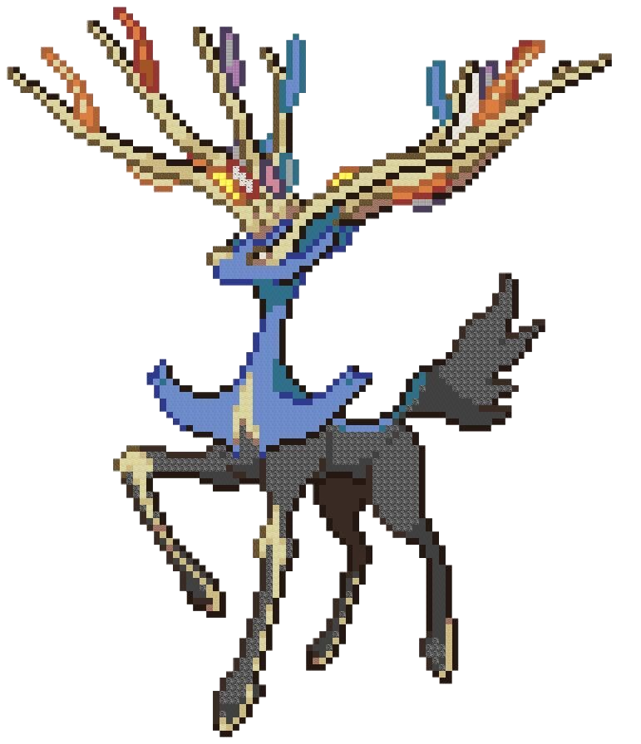


ANALYSIS
:Lv1A
Legendary
Special Class
Pokémon
Sub-legendary
Mythical
Notes:
LAUREN
Special class PKMN are split into 3 categories. Legendaries and sub-legendaries are extremely powerful and tend to appear near the finale of the game as a final "boss level". They can be captured and added to a player's pokedex. Mythicals are very rare, have special abilities, and can be found once a player has completed a specific quest. Every generation of pokemon games has its own unique set of legendaries, sub-legendaries, and mythicals.
For the following analysis, we will be looking at all three categories of special class pokemon.
Picture sources (from left to right):
MewTwo - https://br.pinterest.com/fuzarinicolas/lego-watch/
Lugia - http://pixelartmaker.com/art/4101a0a4f8de55d
Rayquaza - https://pokemondb.net/pokedex/rayquaza
Giratina - https://www.pinterest.ca/pin/658088564280414167/
Terrakion - https://pokemondb.net/sprites/terrakion
Xerneas - https://www.pinterest.ph/WhiteSpriggan/legendary-pokemon-pixel/
Null - https://pokemondb.net/pokedex/type-null
Zacian - https://pokemondb.net/pokedex/zacian

Slide 14
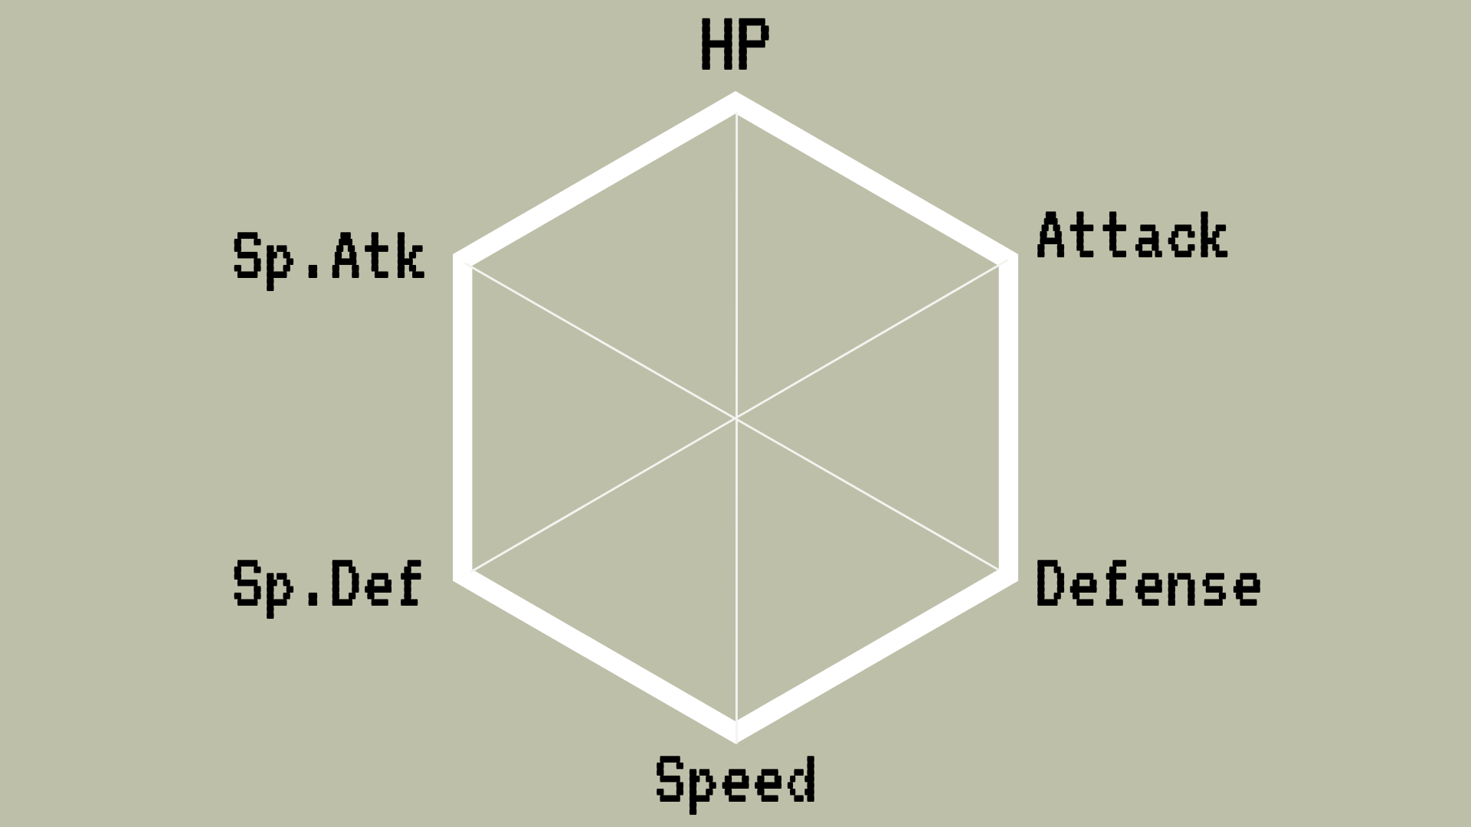

ANALYSIS
:Lv1B
Generation 8
STAT | LARGEST % CHANGE (using Generation 1 as baseline for comparison)
HP | 0.150 Gen 8
Attack | 0.179 Gen 6
Defense | 0.130 Gen 4
Sp.Atk | -0.010 Gen 2
Sp.Def | 0.202 Gen 3
Speed | 0.018 Gen 5
Generation 5
Generation 6
Generation 3
Generation 4
Generation 1
Notes:
LAUREN – infographic #1 and #2
Displayed on the left is each respective generation's highest base stat. As you can see, it seems that each generation excels in certain aspects compared to others. Displayed on the right are the largest percent changes that occurred between generations. Generation 1 was used as the baseline for comparison to calculate these percentage changes. As shown, there is very little variation in terms of base state from generation to generation. This is presumably because Pokemon can be traded between generations and having fairly equal stats ensures that no single generation offers an unfair advantage in battle or training.
Picture sources - https://bulbapedia.bulbagarden.net/wiki/Stat-enhancing_item

Slide 15



ANALYSIS
:Lv2A
Bulbasaur
First Evolution
Ivysaur
!
!
Second Evolution
Venusaur
Third Evolution
TRAINER LAN: Can you predict a Pokémon's total stats when it evolves?
Notes:
DEWY – question 2
We ask the question if an individual can predict a pokemon’s total statistics when it evolves using the first evolutions individual statistics
Firstly we will test if the first evolution can predict the second, since not all pokemon have three evolutions
Depending on the results of the first question we will test if the second evolution can predict the third.

Slide 16


ANALYSIS
:Lv2A
SUBSET data frame for each evolution of starter Pokémon
MAKE a linear regression model
CREATE user-defined function
STORE results in data-frame for hypothesis testing
H_{o}: Pokémon evolve in a predictable fashion
Mean_{actual} = Mean_{predicted}
H_{a}: Pokémon do not evolve in a predictable fashion
Mean_{actual} ≠ Mean_{predicted}
Notes:
DEWY – question 2 method
We subsetted the scrapped data into three separate dataframe for each evolution of a starter pokemon.
Then, using linear regression, created an equation using the coefficients of the individual statistics and the intercept.
The total statistics of the second evolution is the responding variable of the individual variables

Slide 17
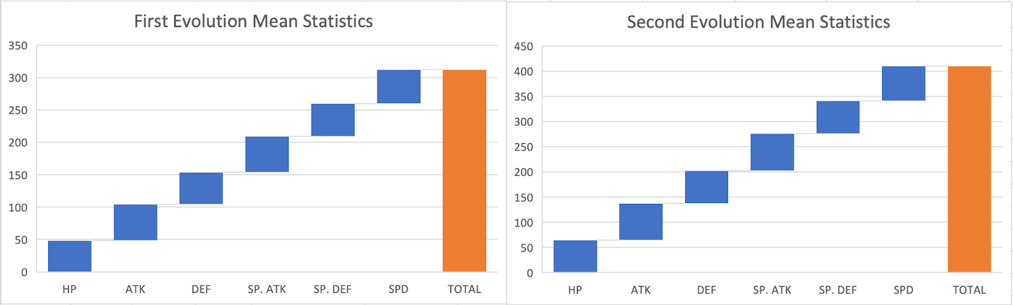
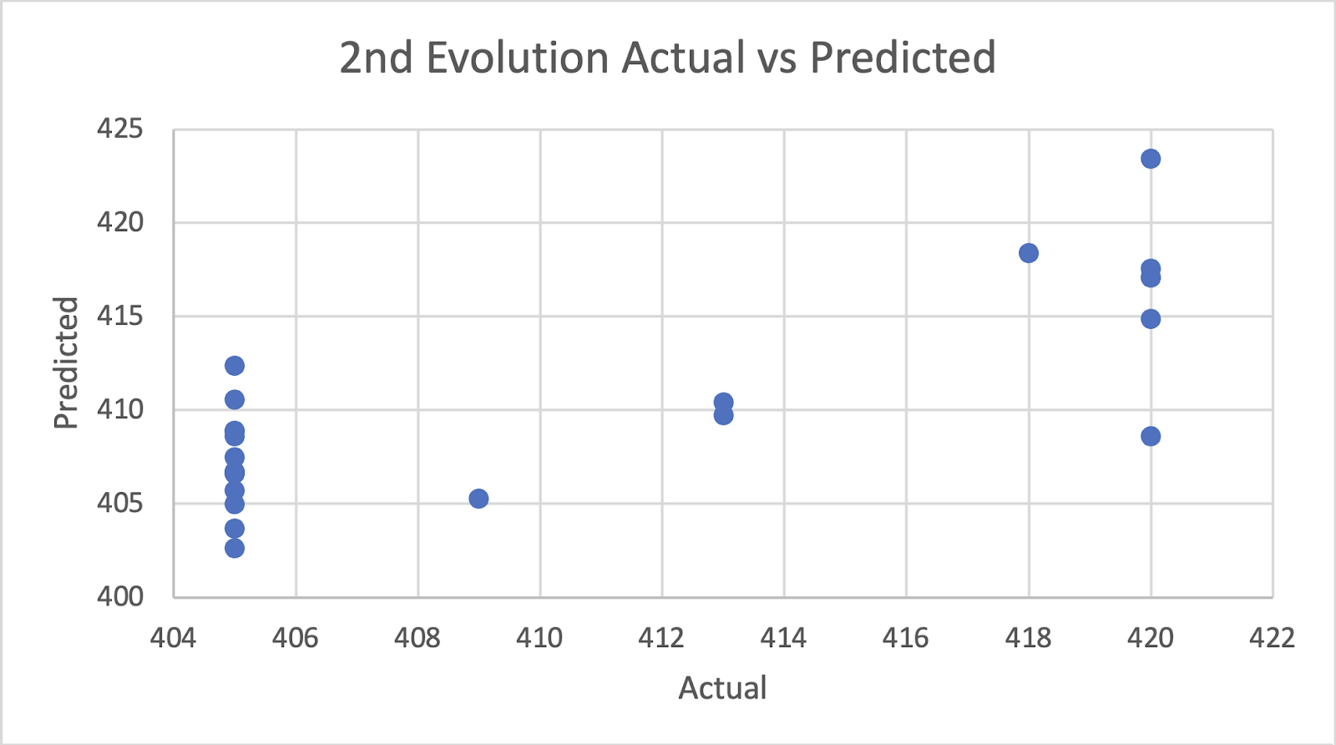
ANALYSIS
:Lv2A
Equation predicting the 2nd Generation's TOTAL statistic
TOTAL_{second} = 1.1538(HP_{first}) + 0.3550(ATK_{first}) +0.2963(DEF_{first}) +
0.3563(Sp. ATK_{first}) + 0.4013(Sp. DEF_{first}) + 0.7693(SPD_{first}) + 238.97
With 95% confidence and 5% alpha level...
Notes:
DEWY - Question 2 analysis
The equation was then input into a user-defined function
The results of this user-defined function are the predicted total statistics of the evolution using the individual statistics of the prior evolution.

Slide 18
ANALYSIS
:Lv2A
Shapiro-Wilks Normality Test Results
Actual TOTAL test result: 7.154*10-6
Predicted TOTAL test result: 0.04298
Non-normal data
Two-tailed Wilcoxon Signed Rank Test
Two-Tailed Wilcoxon Signed Rank Test:
P-value of test: 0.8081
FAIL TO REJECT the null hypothesis.
Notes:
The data is naturally paired with a before and after effect
We then tested for normality for actual and predicted total using the shapiro-wilks test
Both P-values fell within our rejection range and are not considered normal
This indicates the use of the Wilcoxon Signed Rank Test
The p-value of this test is 0.81
Therefore we fail to reject the null hypothesis.
Since we fail to reject the null hypothesis we will check if the second evolution can predict the third

Slide 19
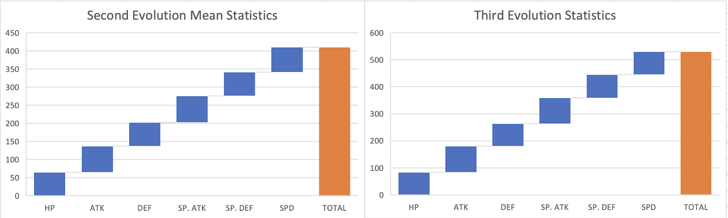
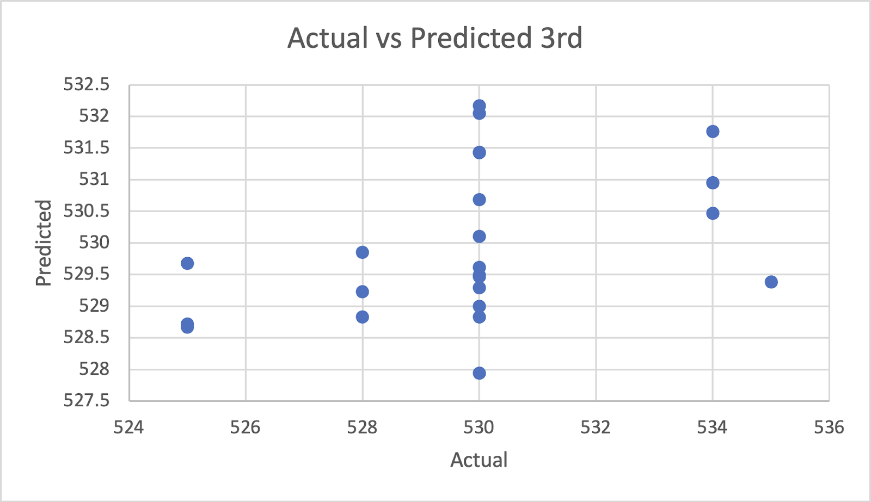
ANALYSIS
:Lv2B
Equation predicting the 3rd Generation's TOTAL statistic
TOTAL_{third} = -0.11194(HP_{second}) - 0.02419(ATK_{second})- 0.08472(DEF_{second}) - 0.02838(Sp. ATK_{second}) - 0.09992(Sp. DEF_{second}) - 0.04100(SPD_{second}) + 555.95233
Similarly, predict the 3rd generation...
Notes:
We used the same methodology to predict the third evolution using the second evolution's individual statistics.

Slide 20

ANALYSIS
:Lv2B
Shapiro-Wilks Normality Test Results
Actual TOTAL test result: 0.002588
Predicted TOTAL test result: 0.233
Normal/Non-normal data
Two-tailed Wilcoxon Signed Rank Test
Two-Tailed Wilcoxon Signed Rank Test:
P-value of test: 0.8977
Alakazam used FUTURE SIGHT!
It saw that the null hypothesis FAILED to be rejected.
Notes:
We used the same methodology to predict the third evolution using the second evolution’s individual stats
Again we use the shapiro-wilks test for testing normality
That actual total is not normally distributed
However, the predicted total is,
Yet since one of the samples are not normally distributed we must still use the Wilcoxon Signed Rank Test
The p-value of this test is 0.9
Therefore, we fail to reject the null hypothesis.
We conclude that an individual can roughly predict a pokemon’s total statistics using the prior evolution’s individual statistics.
Question 2 - recommendation
Yet during the analysis we noticed a discrepancy between the actual and predicted TOTALs on an individual level, making an argument to not evolve pokemon if the difference is negative. This is useful for players looking to have only the strongest pokemon.

Slide 21


















ANALYSIS
:Lv3A
!
!
TRAINER CHRIS: Which Pokémon type has the highest average base stats?
Notes:
CHRIS – question 3

Slide 22
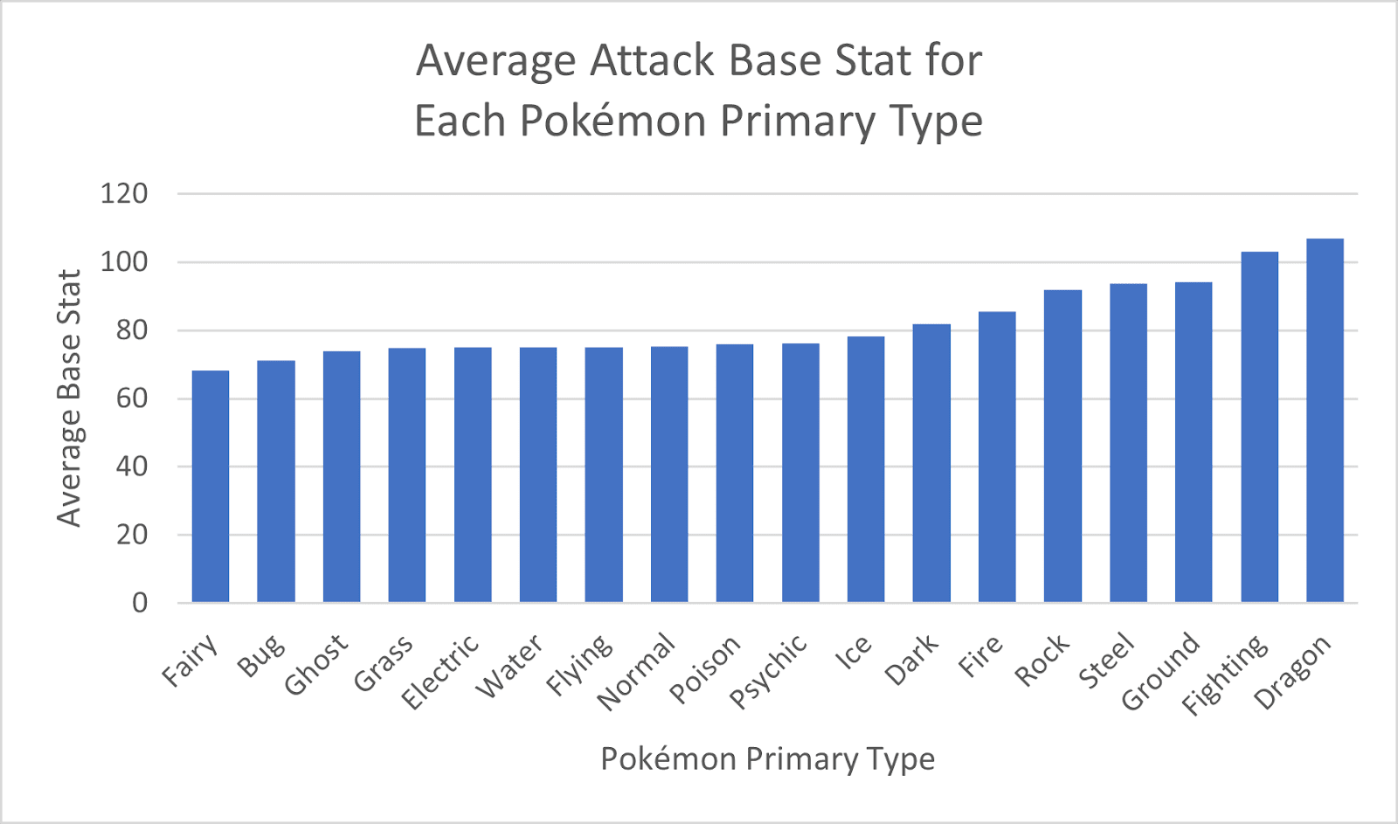
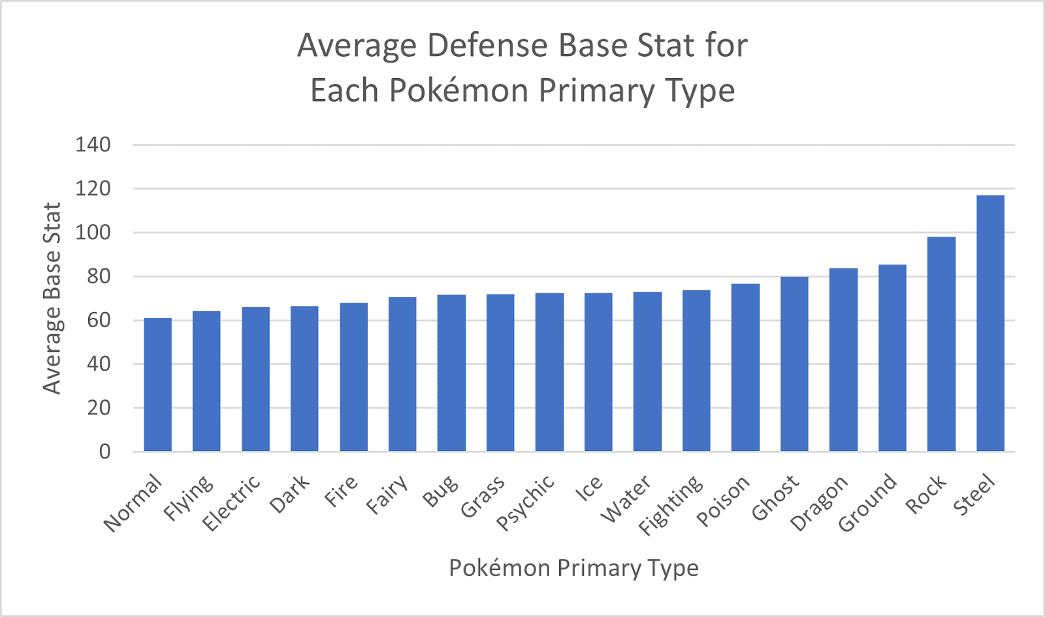

ANALYSIS
:Lv3A
Primary Types with best base attack
Primary Types with best base defense
Notes:
CHRIS – question 3 results
Here are the visualizations comparing the average base attack and defense stats of each type. For base Attack stat, Dragon and Fighting type clearly have a higher average than the rest of the types with Ground making a close third. Further analysis would be required to see if Ground is statistically higher than Steel and Rock type attackers. In terms of defense stats, Steel and Rock types clearly have a higher average than the rest of the types with Ground again making a close third. Further analysis would have to be conducted to see if Ground was statistically different than Dragon.

Slide 23
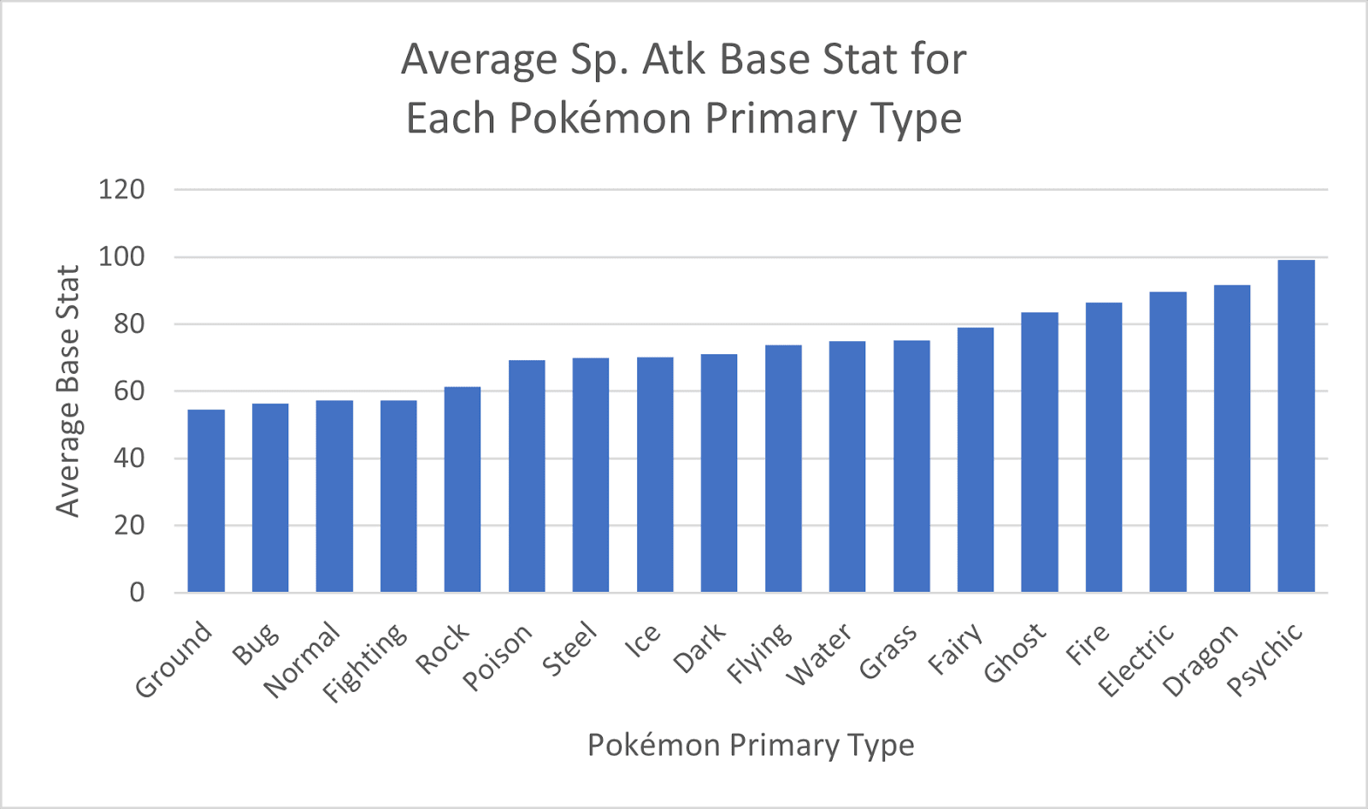
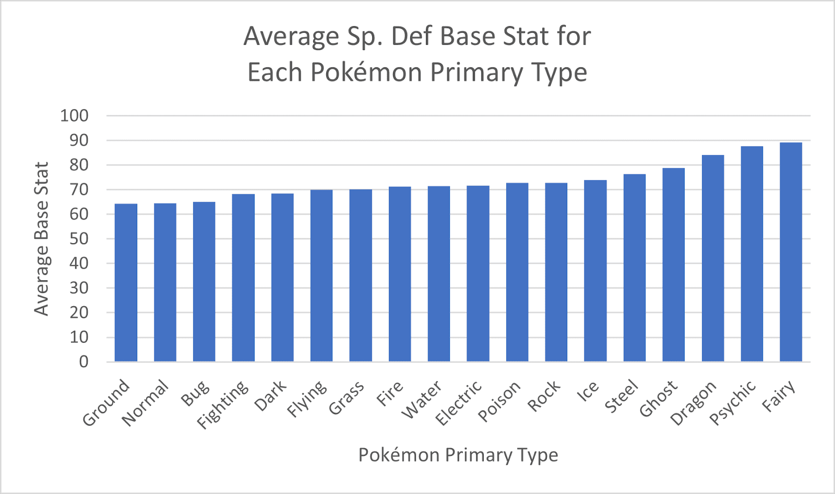
ANALYSIS
:Lv3A
Primary Types with best base special attack
Primary Types with best base special defense
Notes:
CHRIS – question 3 results
In terms of special attack and special defense, these are their visualizations. For average special attack, Psychic, Dragon and Electric primary types rank in the top three, and for average special defense, Fairy, Psychic and Dragon primary types rank in the top three. Unlike the attack and defense visualizations, there is a large enough difference between Fire and Electric for special attack, and between Dragon and Ghost to visually conclude that they are different.

Slide 24




ANALYSIS
:Lv3A
Therefore, conclude that...
Notes:
CHRIS – question 3 results
Based on these visualizations, we can note that primary Dragon types rank within the top 3 types for 3 out of the 4 stat categories, attack, special attack, and special defense. If we are only to look at these visualizations, primary Dragon type Pokemon are on average the strongest. Additionally, both Psychic and Ground primary types rank within the top 3 for 2 out of the 4 stat categories. Once again, if we are only to look at these visualizations, Psychic and Ground primary types would, on average, tie for 2nd strongest type.
These type rankings are important because they compare the average raw strength of each of the types, however they do not consider type matchups which are another major portion of the game. For example, if a player was to choose a Dragon type pokemon for battle purely due to the type's average stats, they would face resistance from a player selecting a fairy type for its high average special defense stat because of Fairy type Pokemon's resistance. As well, because Dragon type pokemon take double the damage from Fairy type attacks, the Dragon type would face an additional weakness. This may downgrade Dragon type's #1 top overall ranking if Fairy type Pokemon are common enough, however further analysis would need to be conducted.
Additionally, the analysis of each primary type's average stat amounts assumes that, on average, that the importance of Pokemon that were designed to either be a good defender or attacker were not nullified. The thought process behind this is that if within a single type there are two pokemon, one of them with a high attack stat and low defense stat, and the other with the inverse, that these two Pokemon will average each other out, resulting in the type appearing to be average. To confirm or deny if this is a problem, we conducted the following sub question.

Slide 25




ANALYSIS
:Lv3B
TRAINER CHRIS: Is there a significant negative correlation between the attack (special attack) and defense (special defense) stats of Pokémon?
Notes:
CHRIS – question 3b
The subquestion is is there a signficiant correlation between the attack or special attack and the defense or special defense stats of Pokemon? This question will help confirm or deny if there is an overall trend among individual pokemon for their defense or special defense stat to decrease as their attack or special attack stat increases.

Slide 26
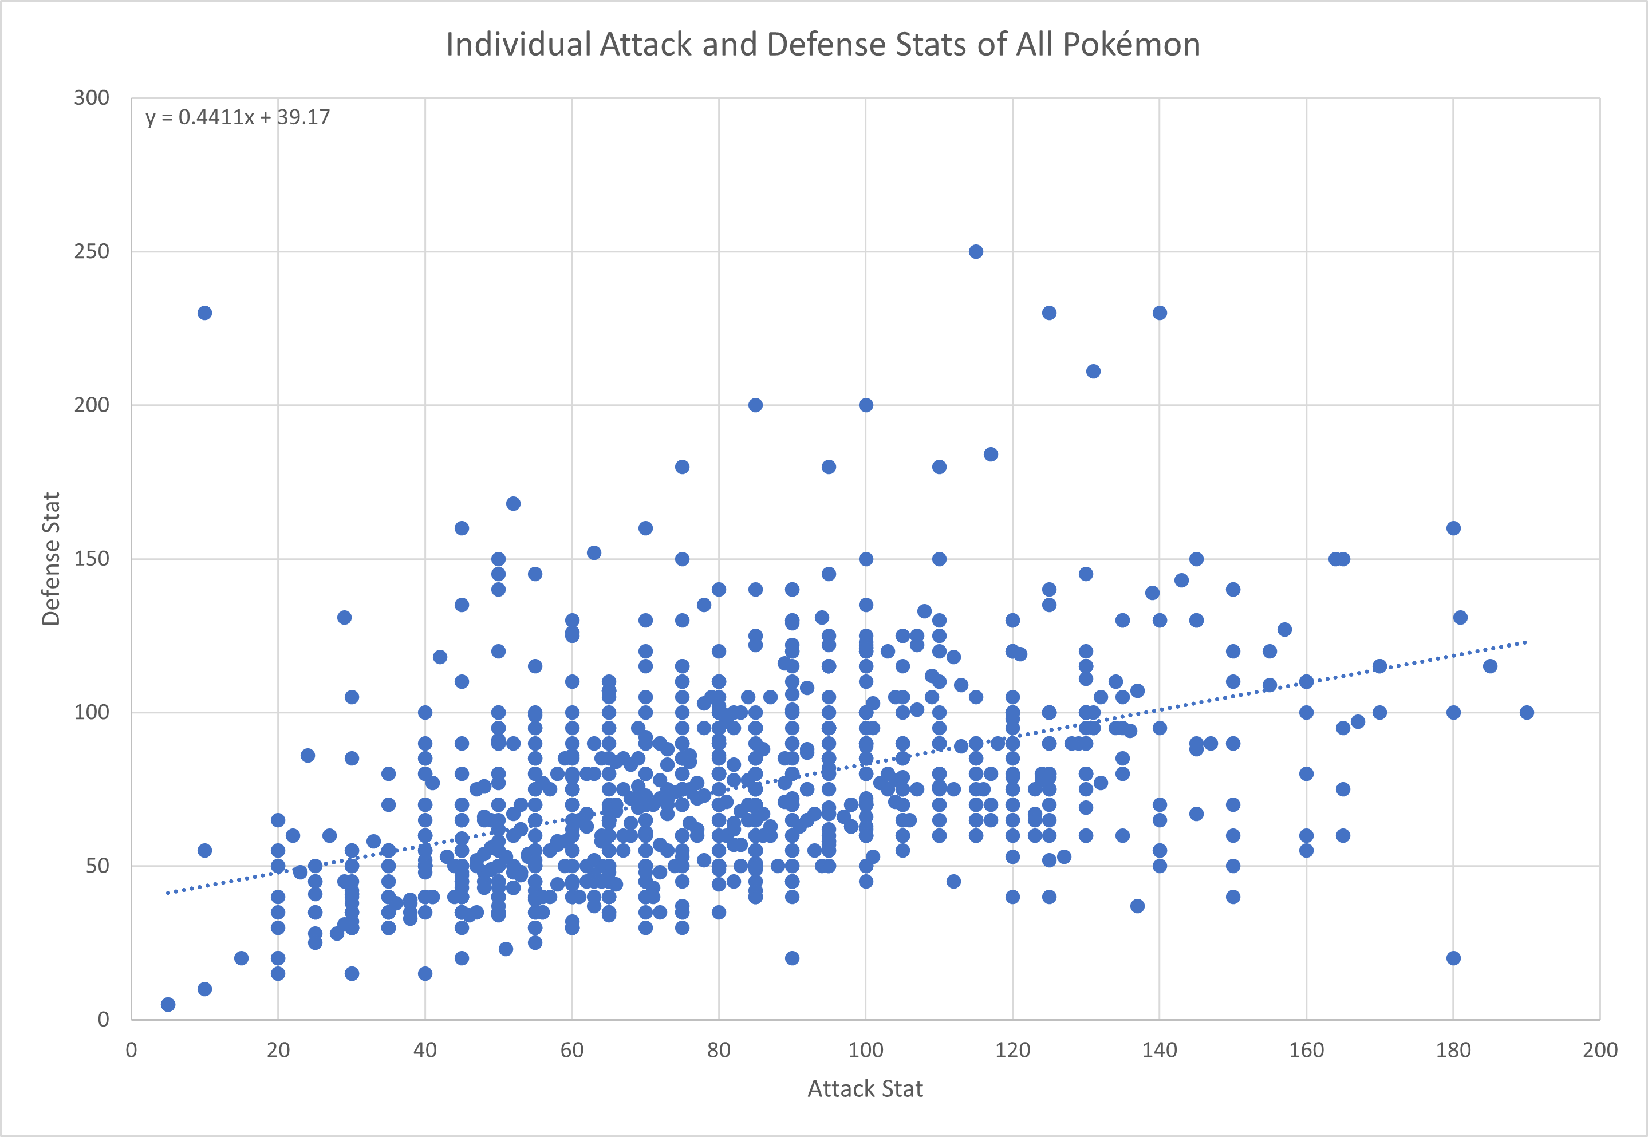
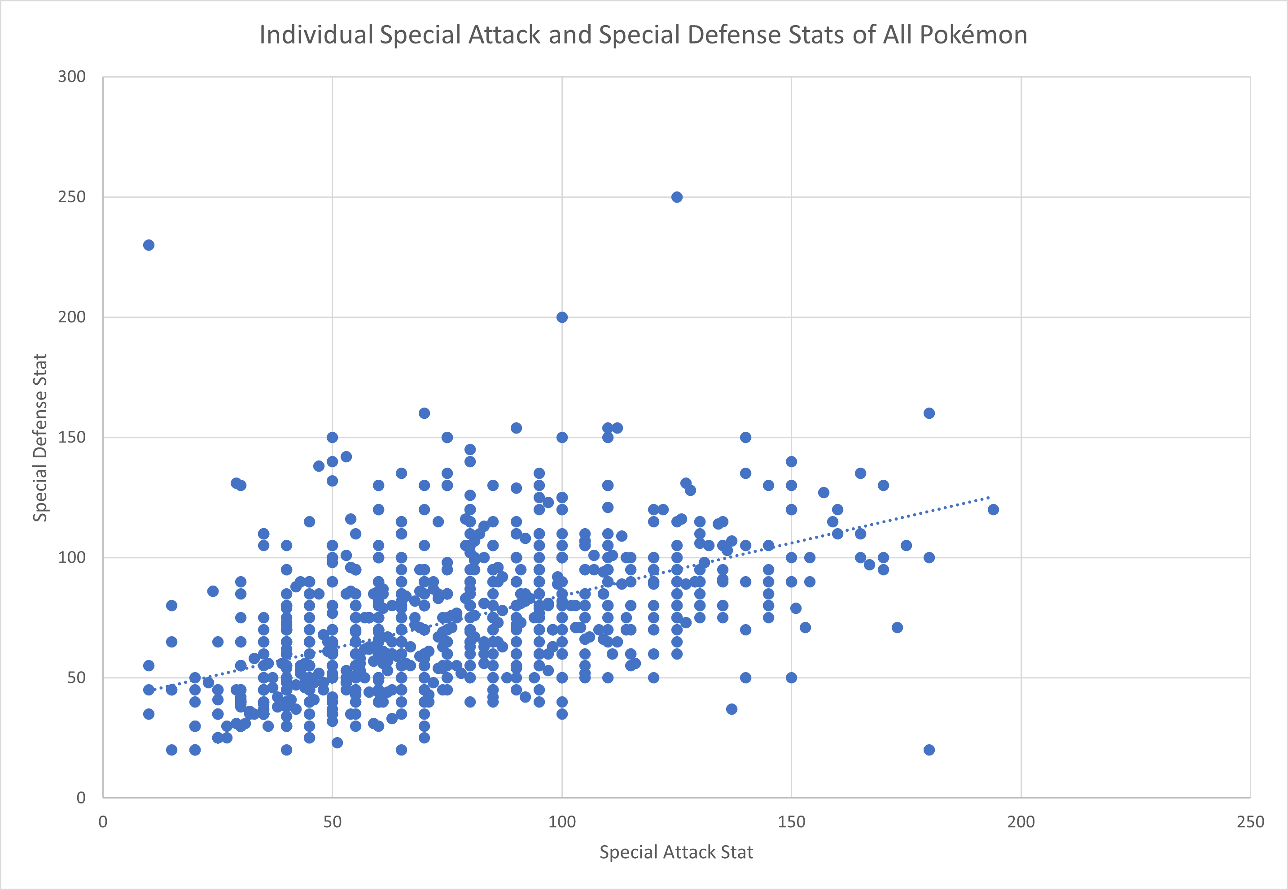
ANALYSIS
:Lv3B
Both plots imply that ...
Notes:
CHRIS – question 3 results
Both of the scatter plots show that there is actually a positive correlation within the two pairs, and their corresponding correlation coefficients support this as they are 0.45767 for attack and defense, and 0.51198 for special attack and special defense.
Both of these plots, as well as their corresponding correlation coefficients of 0.45767 and 0.51198 imply that there is not a strong negative correlation between the stats of each pair
Instead, there is a moderate positive correlation between the stats of each pair

Slide 27
ANALYSIS
:Lv3B
correlation coefficient = 0.45767
correlation coefficient = 0.51198
Notes:
CHRIS – question 3 results
Both of the scatter plots show that there is actually a positive correlation within the two pairs, and their corresponding correlation coefficients support this as they are 0.45767 for attack and defense, and 0.51198 for special attack and special defense.
Both of these plots, as well as their corresponding correlation coefficients of 0.45767 and 0.51198 imply that there is not a strong negative correlation between the stats of each pair
Instead, there is a moderate positive correlation between the stats of each pair

Slide 28
ANALYSIS
:Lv3B
There IS a moderate positive correlation...
Notes:
CHRIS – question 3 results
Both of the scatter plots show that there is actually a positive correlation within the two pairs, and their corresponding correlation coefficients support this as they are 0.45767 for attack and defense, and 0.51198 for special attack and special defense.
Both of these plots, as well as their corresponding correlation coefficients of 0.45767 and 0.51198 imply that there is not a strong negative correlation between the stats of each pair
Instead, there is a moderate positive correlation between the stats of each pair

Slide 29



ANALYSIS
:Lv3B
IF attack or special attack stat is higher, expect that defense or special defense stat will also be higher
CONFIRMS that comparing the average base stats of Pokémon types is valid
Therefore, moderate positive correlation means...
Notes:
CHRIS – question 3 results
Due to this moderate positive correlation between the stats in each pair, when a pokemon's attack or special attack increases, it can be expected that its corresponding defense stat will also be higher. This analysis confirms that comparing the average base stats of Pokemon types is valid. However, it is still important to note that there are some outliers that do not follow this trend as the game intended whereby a Pokemon may have extremely high attack and extremely low defense, or a similar combination with special attack and special defense. These outliers do exist, however they do not represent all Pokemon.
Due to the moderate positive correlation between the stats in each pair, when a Pokémon's attack or special attack stat is higher, it can be expected that its defense or special defense stat will also be higher
These results confirm that comparing the average base stats of Pokémon types is valid. Returning to a point I raised in the discussion of question 3, Levi will examine the distribution of all Pokemon across primary types, and which a trainer would likely see in battle.
Picture sources
Plusle and minun - https://www.pixilart.com/art/minun-and-plusle-960cf13ee77763a
Nidoran and nidoran - http://pixelartmaker.com/art/0fe3e828f8baaa7, https://www.deviantart.com/soulgreyman/art/Nidoran-Female-Big-369690176

Slide 30
ANALYSIS
:Lv3B
IF attack or special attack stat is higher, expect that defense or special defense stat will also be higher
CONFIRMS that comparing the average base stats of Pokémon types is valid
Therefore, moderate positive correlation means...
Notes:
CHRIS – question 3 results
Due to this moderate positive correlation between the stats in each pair, when a pokemon's attack or special attack increases, it can be expected that its corresponding defense stat will also be higher. This analysis confirms that comparing the average base stats of Pokemon types is valid. However, it is still important to note that there are some outliers that do not follow this trend as the game intended whereby a Pokemon may have extremely high attack and extremely low defense, or a similar combination with special attack and special defense. These outliers do exist, however they do not represent all Pokemon.
These results confirm that comparing the average base stats of Pokémon types is valid. Returning to a point I raised in the discussion of question 3, Levi will examine the distribution of all Pokemon across primary types, and which a trainer would likely see in battle.
Picture sources
Plusle and minun - https://www.pixilart.com/art/minun-and-plusle-960cf13ee77763a
Nidoran and nidoran - http://pixelartmaker.com/art/0fe3e828f8baaa7, https://www.deviantart.com/soulgreyman/art/Nidoran-Female-Big-369690176

Slide 31

ANALYSIS
:Lv4A
!
???
TRAINER LEVI: Which primary type is most common among Pokémon? What distribution does it follow?
Notes:
LEVI– question 4
The last part of our report looks into the frequency of all 18 different Pokemon types. Specifically, we want to find out which primary type is most common across every Pokemon in all eight generations. To do this, a new data frame was made with 18 columns, one per Pokemon type. Through the use of the sum() function and filtering accordingly, the data in each column is the number of Pokemon with that respective type as their primary type.

Slide 32
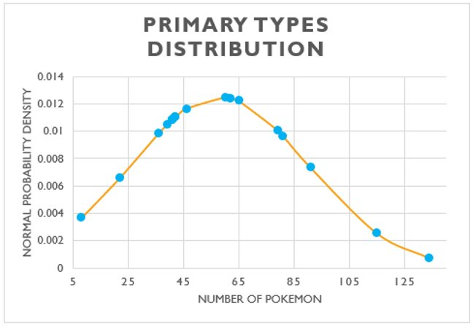
ANALYSIS
:Lv4A
Average # of Pokémon per type
Most common Pokemon type
58
134
Notes:
LEVI – question 4a results
The result of the which.max() function told us that Water is the most common type. The mean number of Pokemon per type came out to 58 with a standard deviation of 31, and more specifically, there were 134 Pokemon that are primary Water types. So clearly the data follows a normal distribution. This puts the number of Water type Pokemon well over 2 standard deviations away from the mean.

Slide 33



ANALYSIS
:Lv4B
ELECTRIKE
BELLOSSOM
GYARADOS
Wild Bellossom and wild Electrike appeared!
Grass and electric type are highly effective against water...
Notes:
LEVI – question 4b
The fourth questions part 2 comes from the fact that Water type Pokemon are the most common. Because of this, it would be statistically beneficial to have either a Grass or Electric type Pokemon in your party as Grass and Electric are super effective against Water. So the question is, which is better to have? A Grass or Electric type in your party?
It is extremely important to note why only the variables of attack power and HP were considered in this analysis as we saw earlier that there are many other variables that could be considred. This is due to the fact that the reason for wanting a Grass or Electric type in your party, is to capitalize on the commonality of Water type Pokemon. More specifically, a Pokemon trainer wants an Electric or Grass type in their party because they are both super effective against Water. It is because of that fact that we look exclusively at the comparison of attack power against health points for electric types and what they're super effective against, as well as grass types and what they are super effective against.
Picture sources (left to right)
Gyrados - https://www.pixilart.com/art/gyarados-sprite-fa05d56af6c56ba

Slide 34
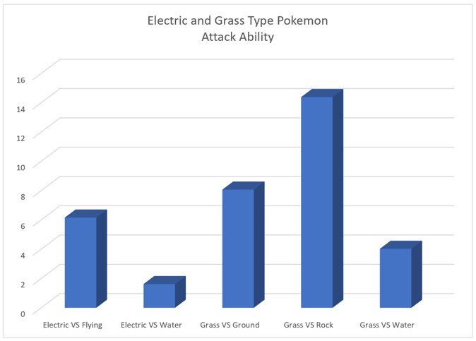
ANALYSIS
:Lv4B
Average HP for
VS.
Average type attack
-3.89
Notes:
So getting into the analysis, through the data we learned that the average attack power for grass types is higher than the average attack power for electric types at 79.41 vs 81.82. Based on that our hypothesis was that grass types are more beneficial, but lets look further into the analysis to reject or fail to reject that.
on the right is a bar chart with grass and electric as compared to the types they are super effective against. TLooking at electric first, the first two bars are electric vs flying and electric vs water respectively. In this analysis we took the average hp of the type being attacked, and subtracted the average attack power of electric type pokemon
Additionally on the left is the average HP for water and flying type pokemon against the average attack power of electric types. THis resulted in an average health point level of –3.89 for water and flying type pokemon.

Slide 35
ANALYSIS
:Lv4B
Average HP for
VS.
Average type attack
-8.83
Notes:
- Going back to the chart, the last 3 bars are grass vs ground, grass vs rock, and grass vs water respectively.
- and then lookin at the averages again on the left, we have the average water ground and rock type pokemon's health points against the average attack power of a grass type pokemon. This results in –8.83.

Slide 36



ANALYSIS
:Lv4B
PRESS START TO CONTINUE!!
Therefore, conclude that...
Notes:
As a result we fail to reject the hypothesis that grass types are more beneficial than electric types as the average grass type leaves their opponent with –8.83 health as comapred to electrics –3.89.
Picture sources
Kyogre - https://www.kindpng.com/imgv/ibiowRm_kyogre-pixel-art-png-download-shiny-kyogre-pixel/
Tropius - https://international-pokedex.fandom.com/wiki/Tropius_(May)
Pokeballs - http://pixelartmaker.com/art/548f2eab06f447e

Slide 37






SUMMARY
Pokémon are equally strong
Base stats are predictable between evolutions
Pokémon types offer different advantages
How to handle the game's most common Pokémon type
Bring a variety of Pokémon to battle!
Notes:
CHRIS - conclusion
Based on our analysis, we conclude that different Pokemon types excel in different situations. In Lauren's question, we observed that there was no large difference between the stats of legendary Pokemon, implying that Pokemon across all generations are equally strong. In Lan's analysis, we saw that the stats of evolved Pokemon can be reasonably be predicted with some discrepancy, and that you should evolve your Pokemon. In Chris' analysis, we saw that depending on which stat was being looked at, there were different types that had better stats than others, for example, Dragon type Pokemon have the highest average attack stat. These stat rankings did not consider individual type weaknesses and resistances. Finally, we saw in Levi's analysis that Water type Pokemon are the most common, and the strongest Pokemon type to choose against them is Grass. These results line up with how the Pokemon games were designed, as players carefully craft teams of Pokemon based on the Pokemon they anticipate to face in battle.

Slide 38
There's only one question left unanswered...
Notes:
CONCLUSION
- thank you for listening to our presentation. Today we answered many questions that beginner pokemon trainers find themselves asking but we have one final, unanswered question...will YOU catch 'em all?

Slide 39
...Will YOU catch 'em all?
Notes:
CONCLUSION
- thank you for listening to our presentation. Today we answered many questions that beginner pokemon trainers find themselves asking but we have one final, unanswered question...will YOU catch 'em all?

